Slide 1

Heap Sort
Presented by Jamil Rayhan
ID: 18CSE061

Slide 2
What is Sort?
Sorting is the process of arranging data into meaningful order
So that we can analyze it more effectively

Slide 3
Heap
Heaps are based on the notion of complete tree.
A binary tree has the heap property if,
Its empty.
The key in the root is larger than that in either and both subtrees have the heap property.

Slide 4
Types of Heap
Min Heap : If the value at the node N, is lass than or equal to the value at each of the children of N, then Heap is called a MIN-HEAP.
In general, a Heap represents a table of N elements or records satisfying the following property;
N_{j} > N_{i} for i < j <n & i = [j/2]

Slide 5
Types of Heap(cont.)
Max Heap : If the value at the node N, is greater than or equal to the value at each of the children of N, then Heap is called a MAX-HEAP.
In general, a Heap represents a table of N elements or records satisfying the following property;
N_{j} < N_{i} for i < j <n & i = [j/2]

Slide 6
Heap Sort
A comparison-based sorting technique based on Binary Heap data structure.
It is similar to selection sort where we first find the min/max element and place the min/max element at the beginning and repeat the same process.

Slide 7
The heap Property
A node has the heap property if the value in the node is as large as or longer than the values in its children.
All leaf node automatically have the heap property.
A binary tree is a heap if all nodes in it have the heap property.
12
12
12
8
3
8
12
8
14
Blue node has heap property
Blue node has heap property
Blue node does not have heap property

Slide 8
Shift Up
Here is node that does not have heap property . We can give it the heap property by exchanging its value with the value of larger child.
This is sometimes called shifting up.
Notice that the child may have lost the heap property.
12
14
8
14
8
12
Blue node does not have heap property
Blue node has heap property

Slide 9
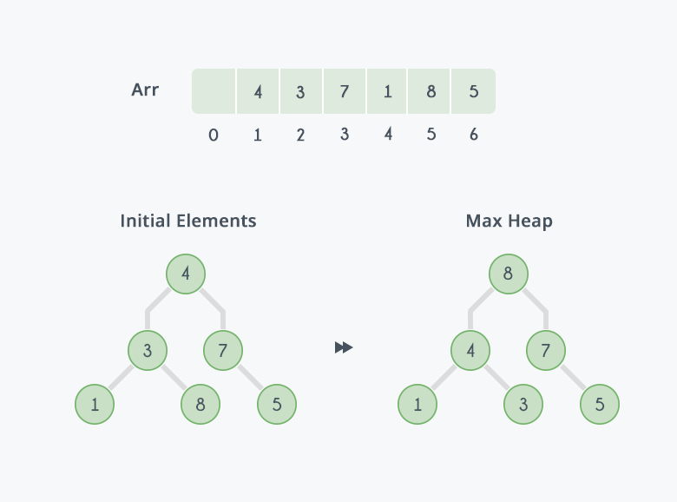
Example: Initially there is an unsorted array Arr having 6 elements and then max-heap will be built.

Slide 10
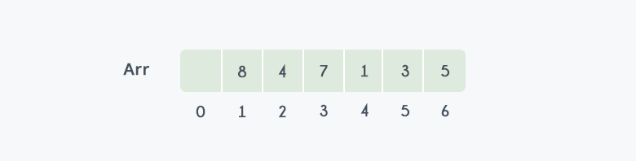
After building max-heap, the elements in the array Arr will be:

Slide 11
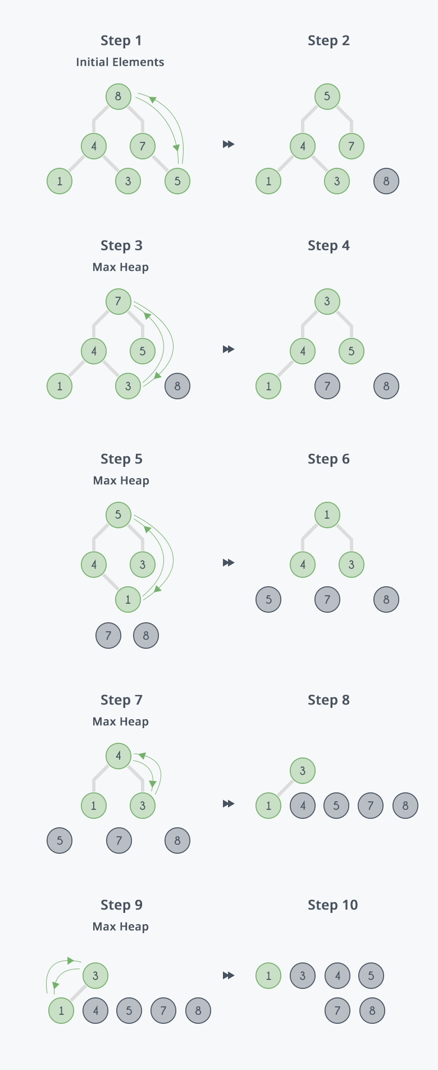

Slide 13

After all the steps, we will get a sorted array.

Slide 14
Algorithm
Build A max/min Heap from the input data.
At this point, the Largest/smallest item is sorted at the root of the heap Replace it with the last item of the Heap followed by reducing the size of Heap by 1.Finally, heaping the root of the tree.
Repeat second step while the size of the Heap is greater than 1.

Slide 15
Time Complexity
Heap sort is an efficient unstable sorting algorithm
Average, best-case and worst-case time complexity of O(n log n).

Slide 16
Advantages
The Heap sort algorithm can be implemented as an in-place sorting algorithm.
Its memory usage is minimal.

Slide 17
Disadvantages
Quick sort is much more efficient than Heap in many cases.
Heap sort make a tree of sorting element.

Slide 18
Thank You

